Slide 1
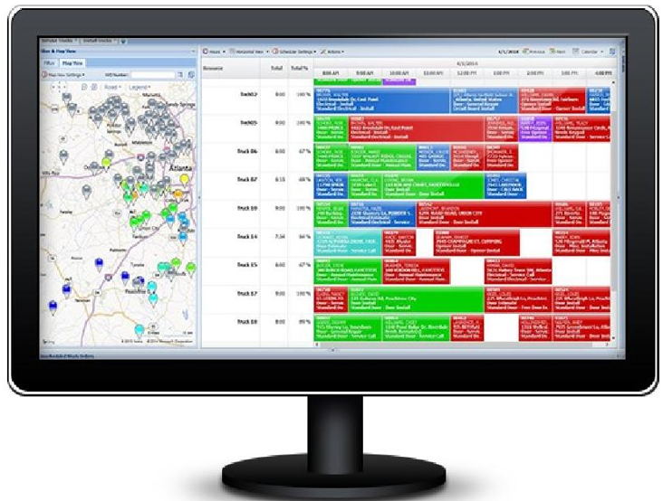

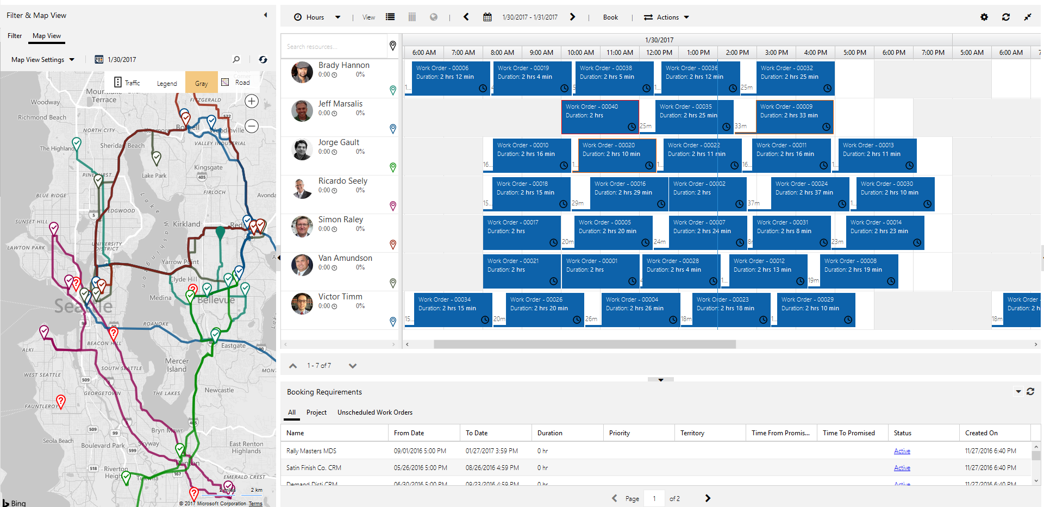
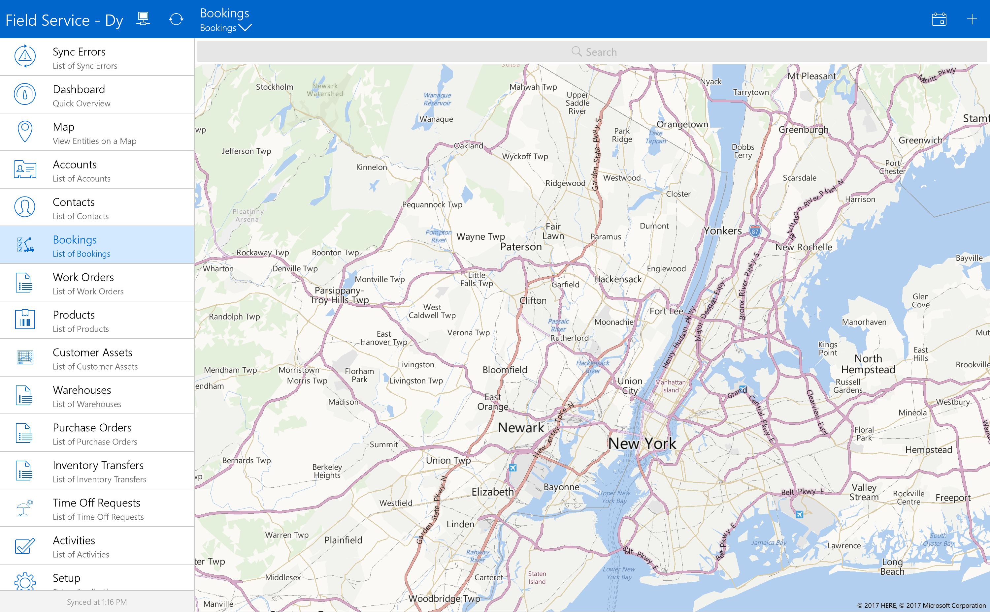

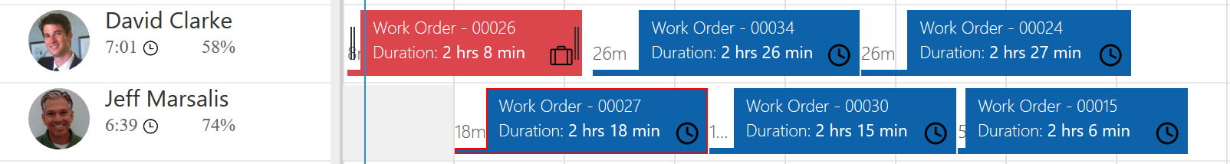
Field agents see optimized appointments on mobile devices.
Dispatchers see optimized appointments across all resources on the interactive schedule board.
Color indicates status
Estimated travel time
Utilization
Border indicates priority

Slide 2
High Level Architecture – Data Flows
Dynamics 365
Resource Scheduling Optimization
Service
Resource Scheduling Optimization Solution
RSO Profiles Define
Objectives & Constraints
Service requests data
Field Service Solution
Data sent to service
Resource schedules
are updated

Slide 3
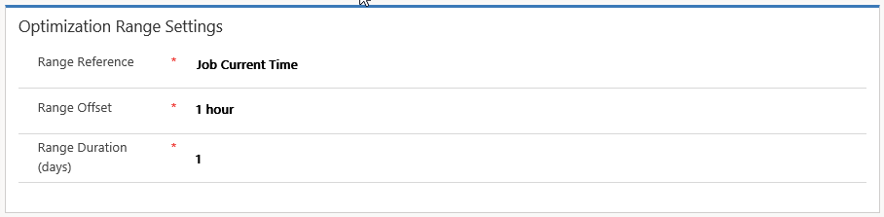
“Schedule requirements for 24 hours, starting one hour from now”
Range Offset = 1h
Range Duration = 1 day
0h
today
Now
0h
tomorrow
Now
+ 24h
48h
Now
+ 48h
time
Range Reference: Job current time
Optimization scope

Slide 4
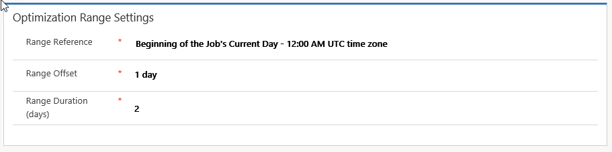
“Optimize bookings for two days in advance but don’t change schedules of the current day”
Range Offset = 1 day
Range Duration = 2 days
Now
+ 48h
time
0h
today
Now
24h
0h tomorrow
Now
+ 24h
48h
72h
Range Reference:
Beginning of Job’s Current Day
Optimization scope

Slide 5
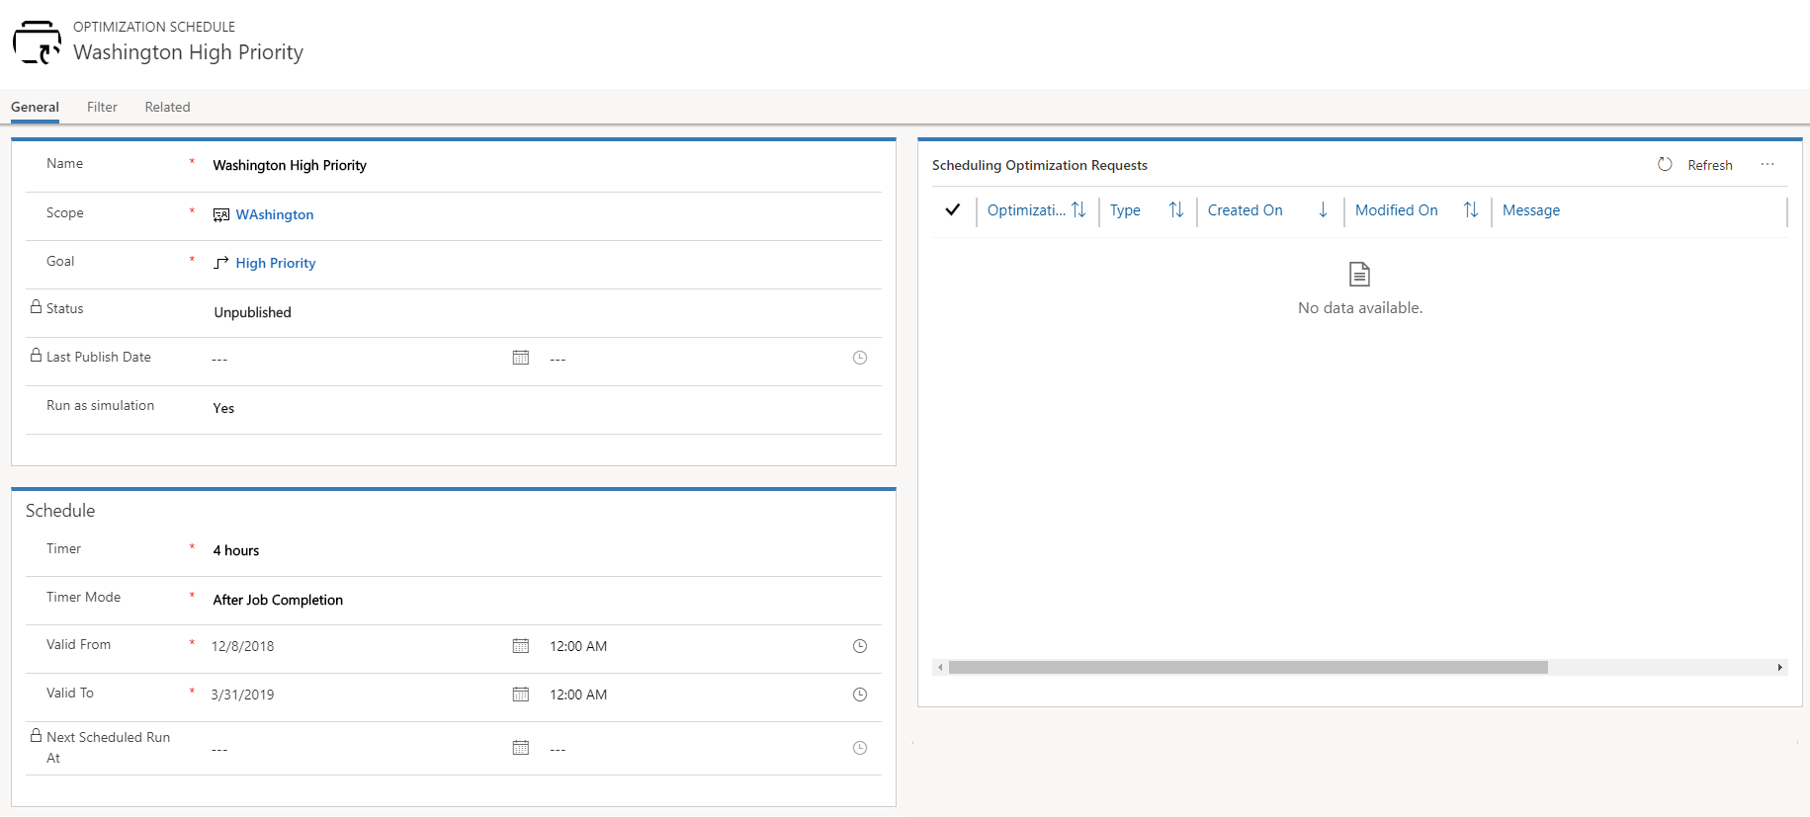
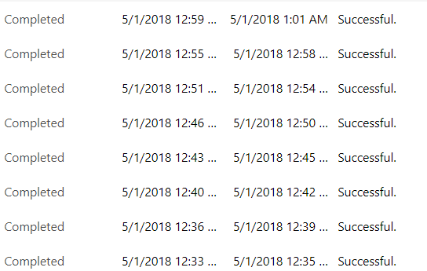
Optimization requests can be monitored. From within each request, resource and booking detail information is available.

Slide 6
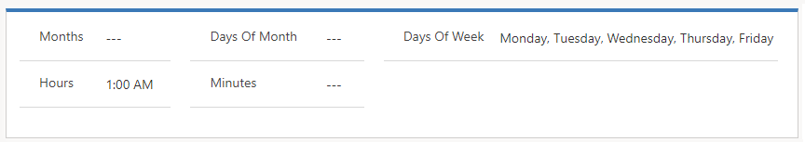
Multiple drop-down boxes provide necessary filter criteria.

Slide 8
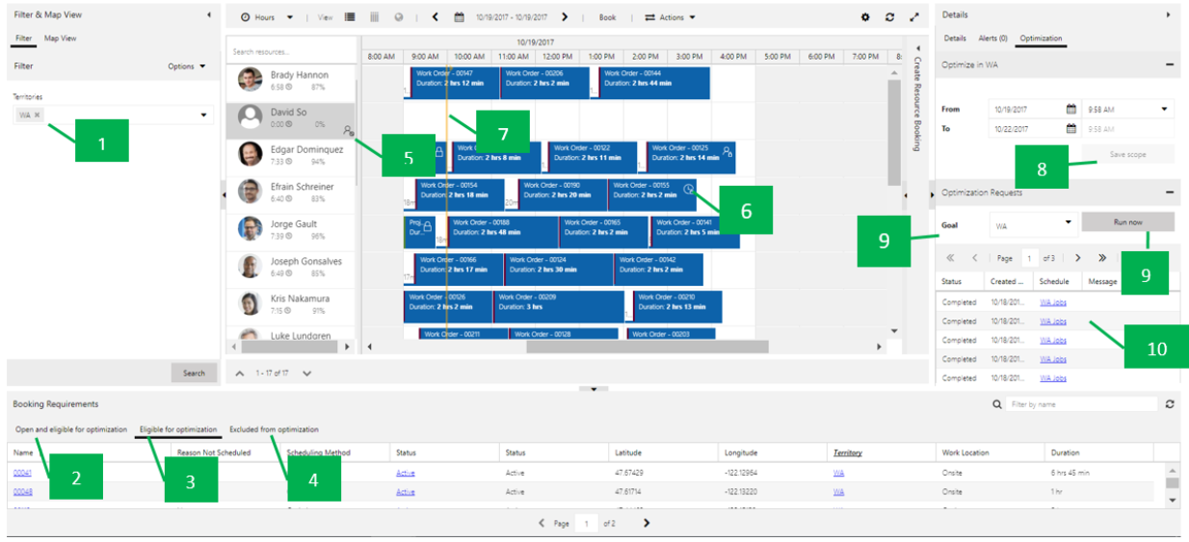
1
7
5
8
6
9
10
11
2
3
4

Slide 9
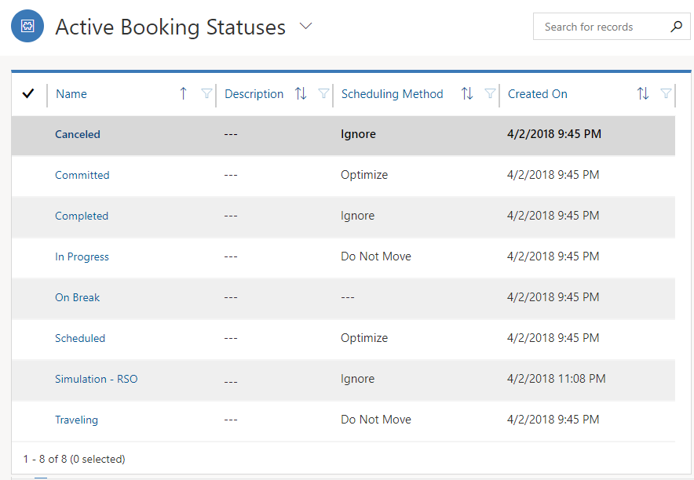
Optimization settings for booking statuses.

Slide 10
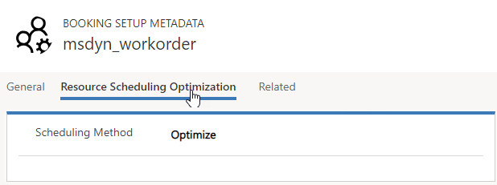
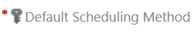
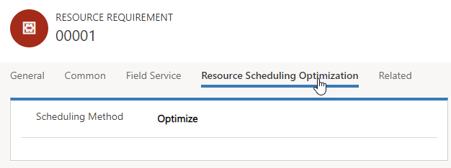
Default setting defined on the Booking Setup Metadata entity.
Requirement optimization setting on existing resource requirement record.

Slide 11
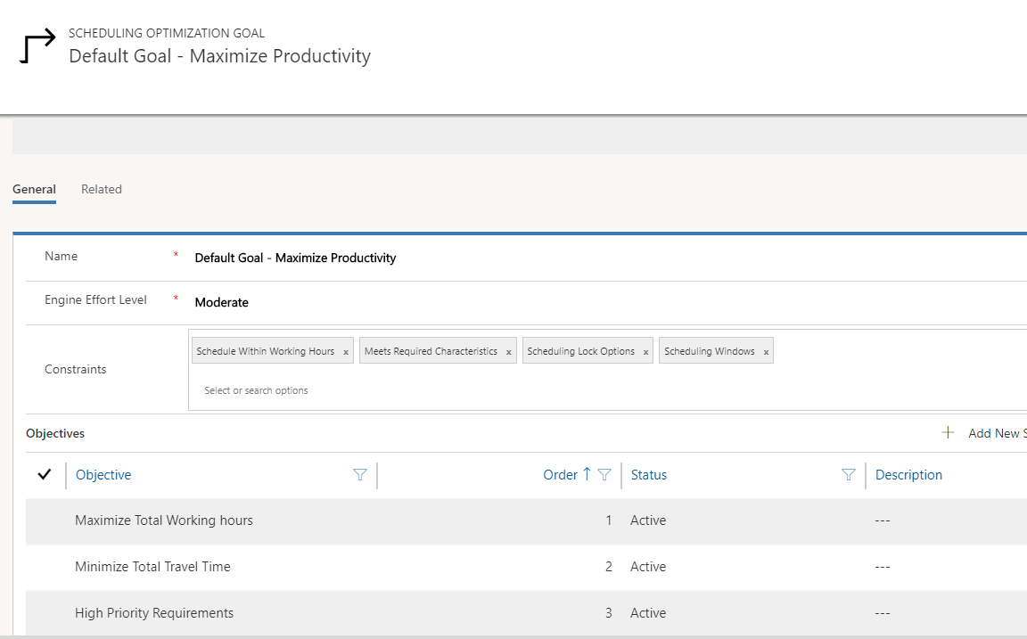

Slide 12
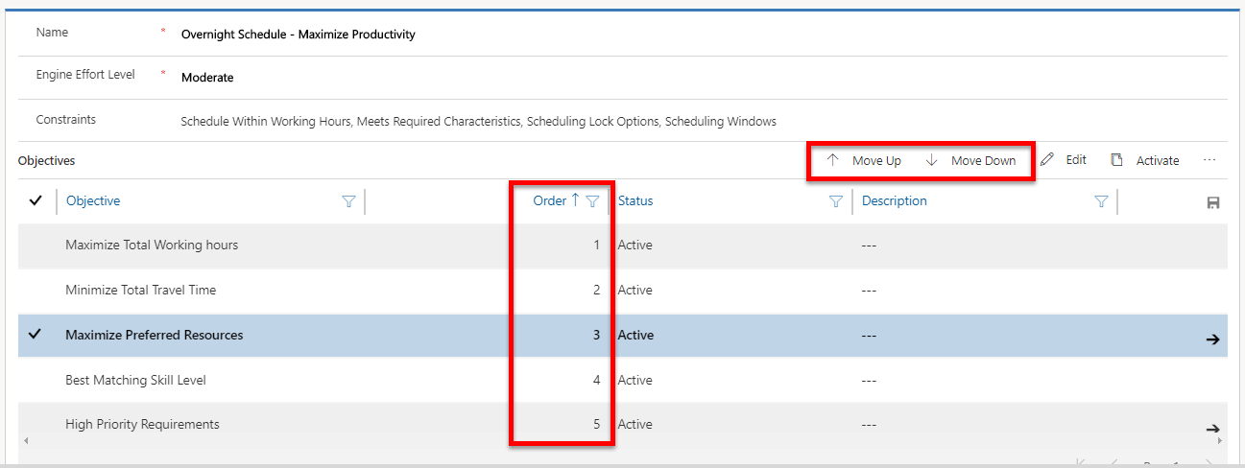

Slide 13
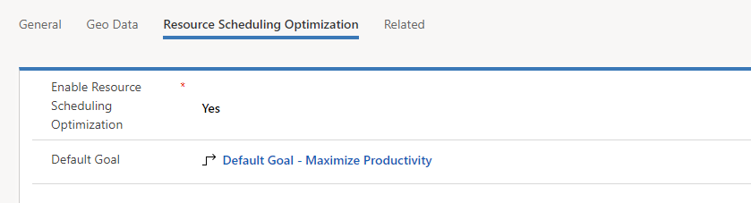

Slide 14
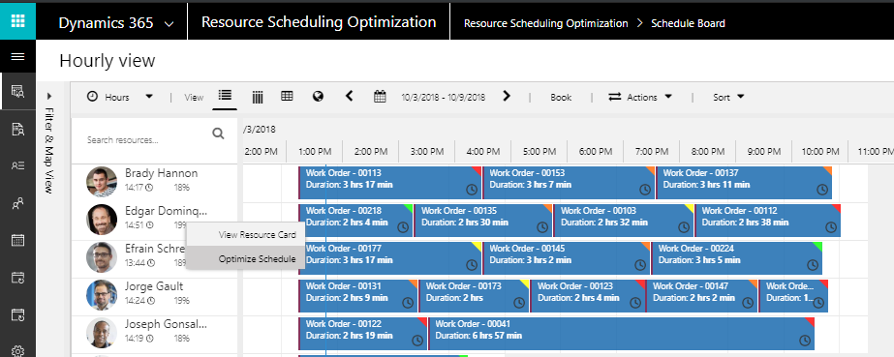
The Default Goal is used when single resource optimization is selected from the schedule board.

Slide 15
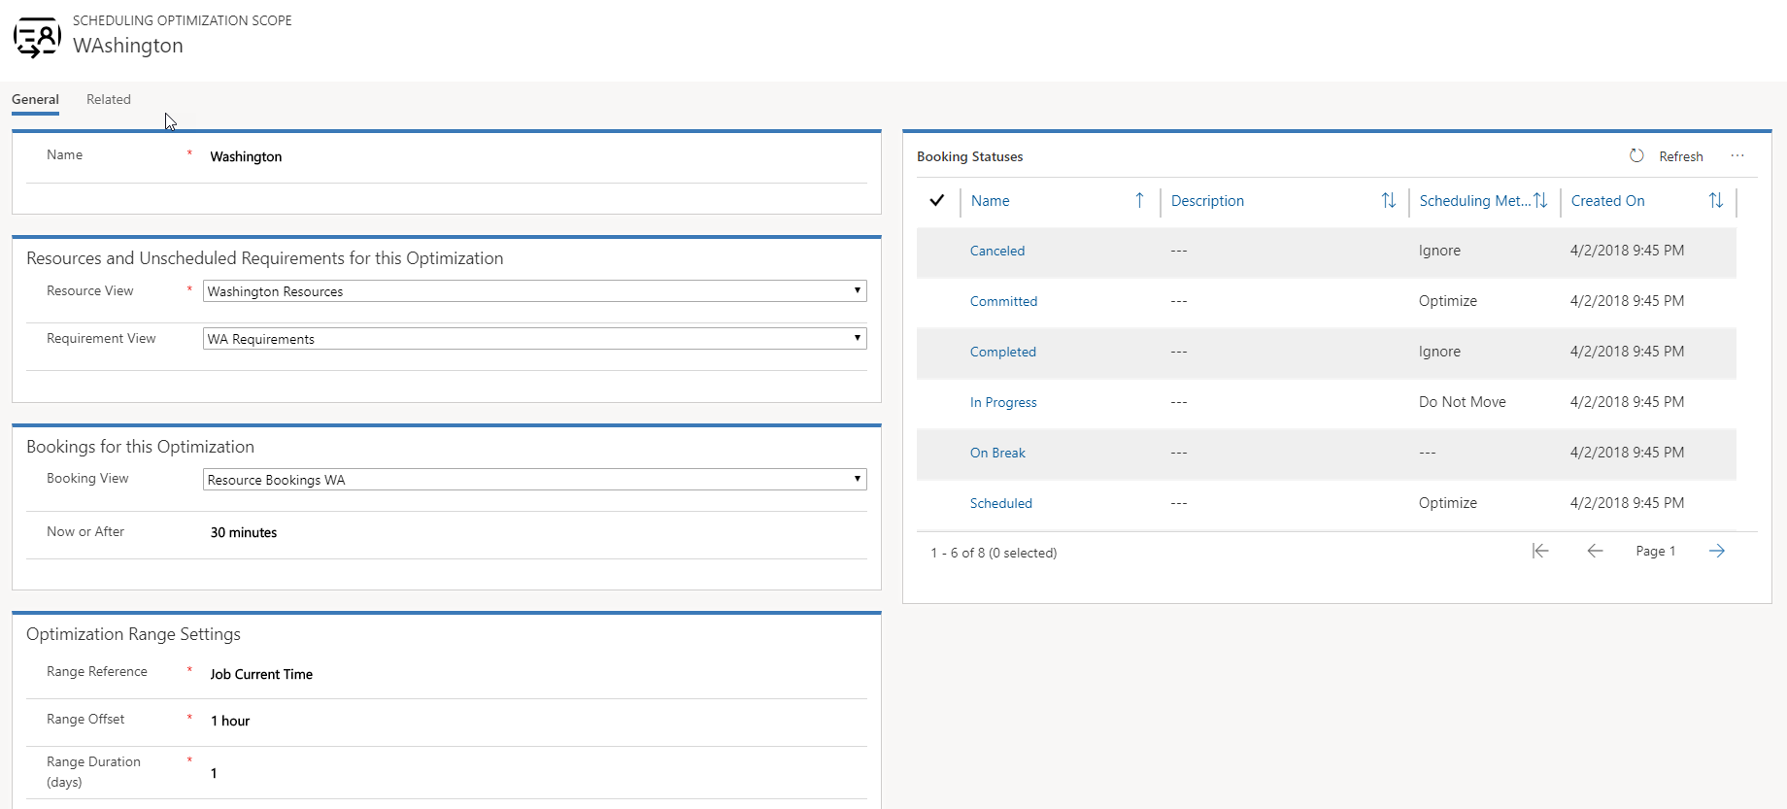
Resource, Requirement, and Booking views define the optimization scope.
Time Range where new booking will be created.

Slide 16
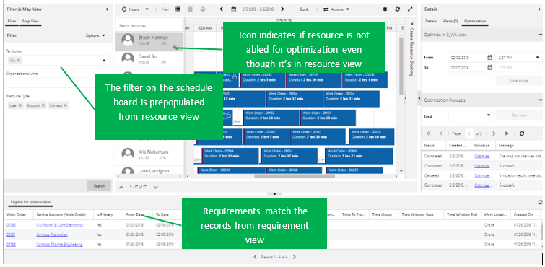
Icon indicates if resource is not enabled for optimization even though it’s in resource view.
The filter on the schedule board is pre-populated from the resource view.
Requirements match the records from the requirement view.

Slide 17
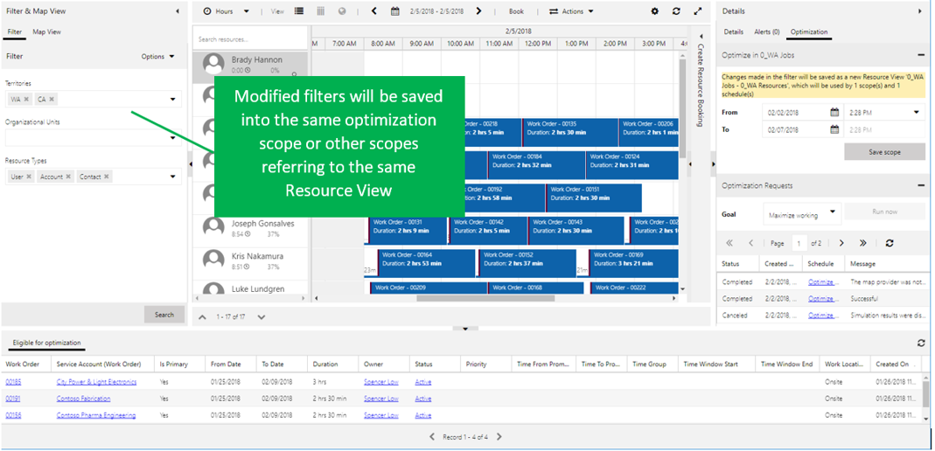
Modified filters will be saved into the same optimization scope or other scopes referring to the same resource view.

Slide 18
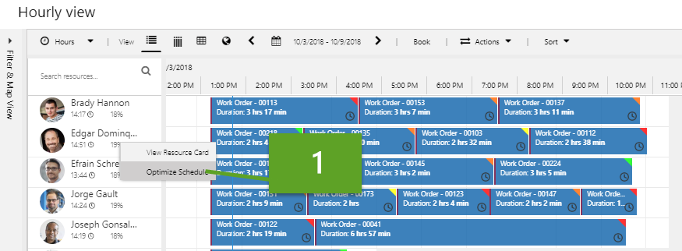
1

Slide 19
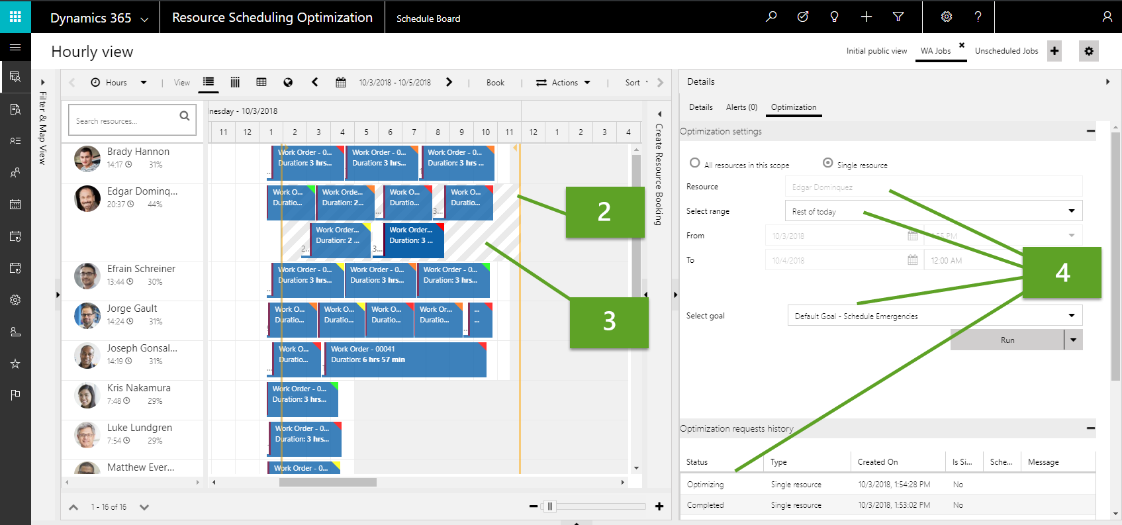
2
4
3

Slide 20
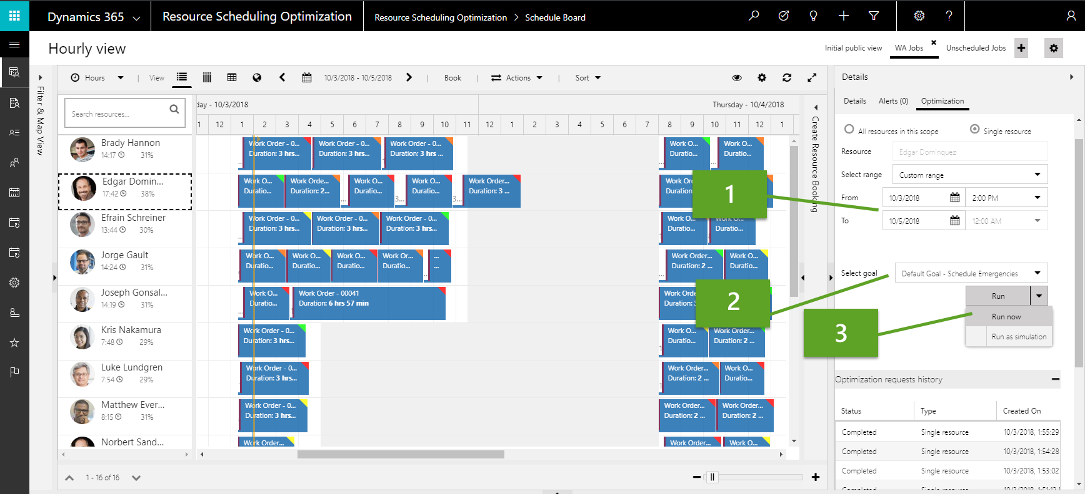
1
2
3

Slide 21
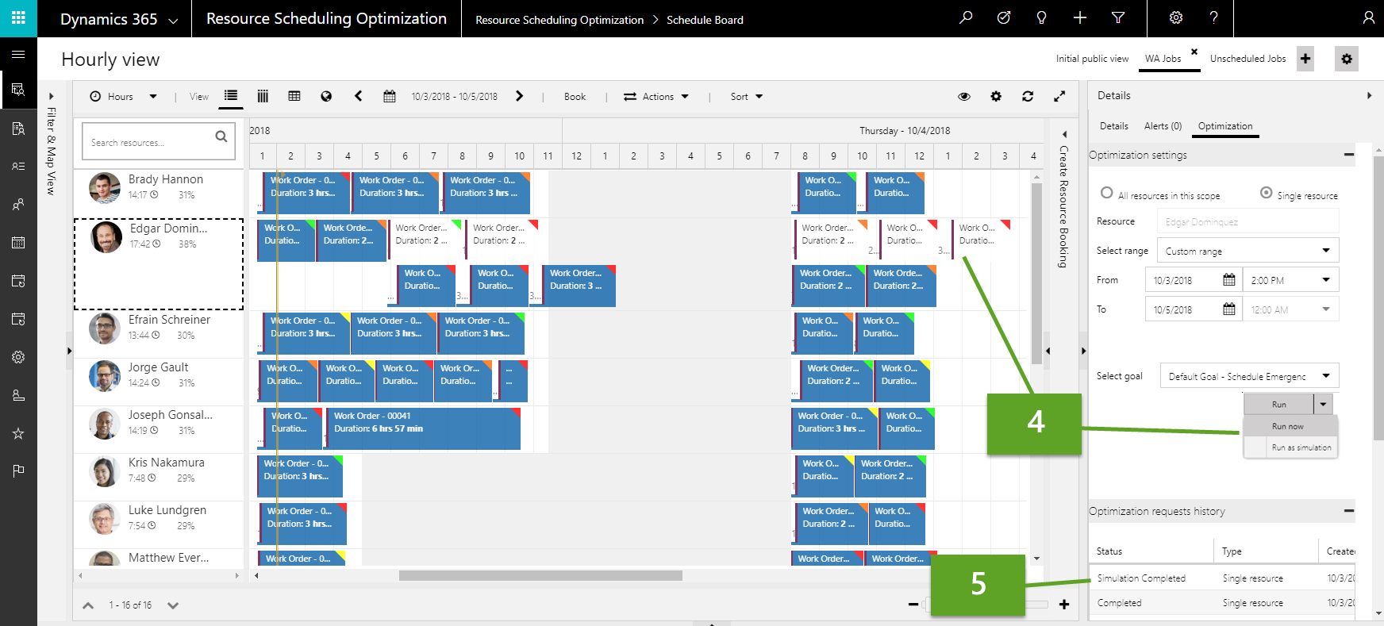
4
5

